Slide 1

Title
Nancy Arora
May24,2026

Slide 2



OUTLINE
Executive Summary
Introduction
Methodology
Results
Visualization – Charts
Dashboard
Discussion
Findings & Implications
Conclusion
Appendix

Slide 3

EXECUTIVE SUMMARY
Summarize key findings here
This project analyzes global developer survey data to identify trends in programming languages, databases, platforms, web frameworks, compensation, demographics, and future technology preferences.
Using Python for data analysis and IBM Cognos Analytics for dashboard visualization, the study highlights the dominance of JavaScript technologies, PostgreSQL, AWS, and Spring Boot, along with important demographic and educational trends among developers.

Slide 4

INTRODUCTION
Purpose of the report, Target Audience & Value of the analysis
Analyze current and future technology trends for technologies
Understand developer demographics
Explore compensation and education patterns
Create interactive dashboards for visualization

Slide 5

METHODOLOGY
Data sources
Survey Based Data from developers
Data collection & Data wrangling steps
Handling missing values
Data transformation
Splitting multi-select columns
Tools & Technologies
Python
Pandas
Matplotlib/Seaborn/Plotly
IBM Cognos Analytics
Analysis Techniques
Descriptive statistics
Visualization
Dashboard creation

Slide 6
Results
HTML/CSS, JavaScript, and TypeScript emerged as the most commonly used and preferred programming languages among developers
PostgreSQL and AWS showed the highest adoption among databases and platforms respectively.

Slide 7
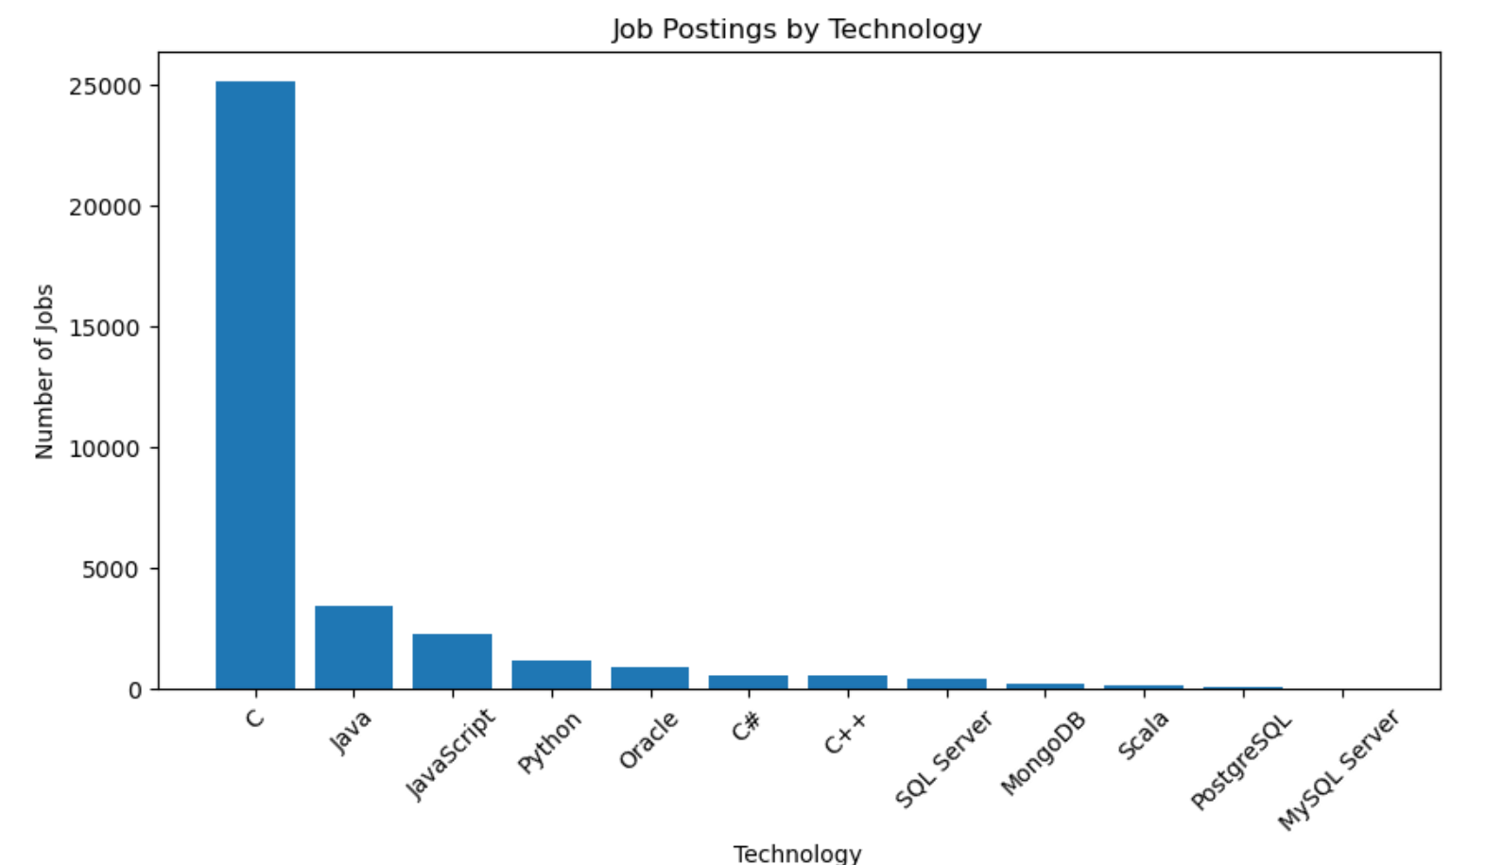
JOB POSTINGS
In Module 1 you have collected the job posting data using Job API in a file named “job-postings.xlsx”. Present that data using a bar chart here. Order the bar chart in the descending order of the number of job postings.

Slide 8
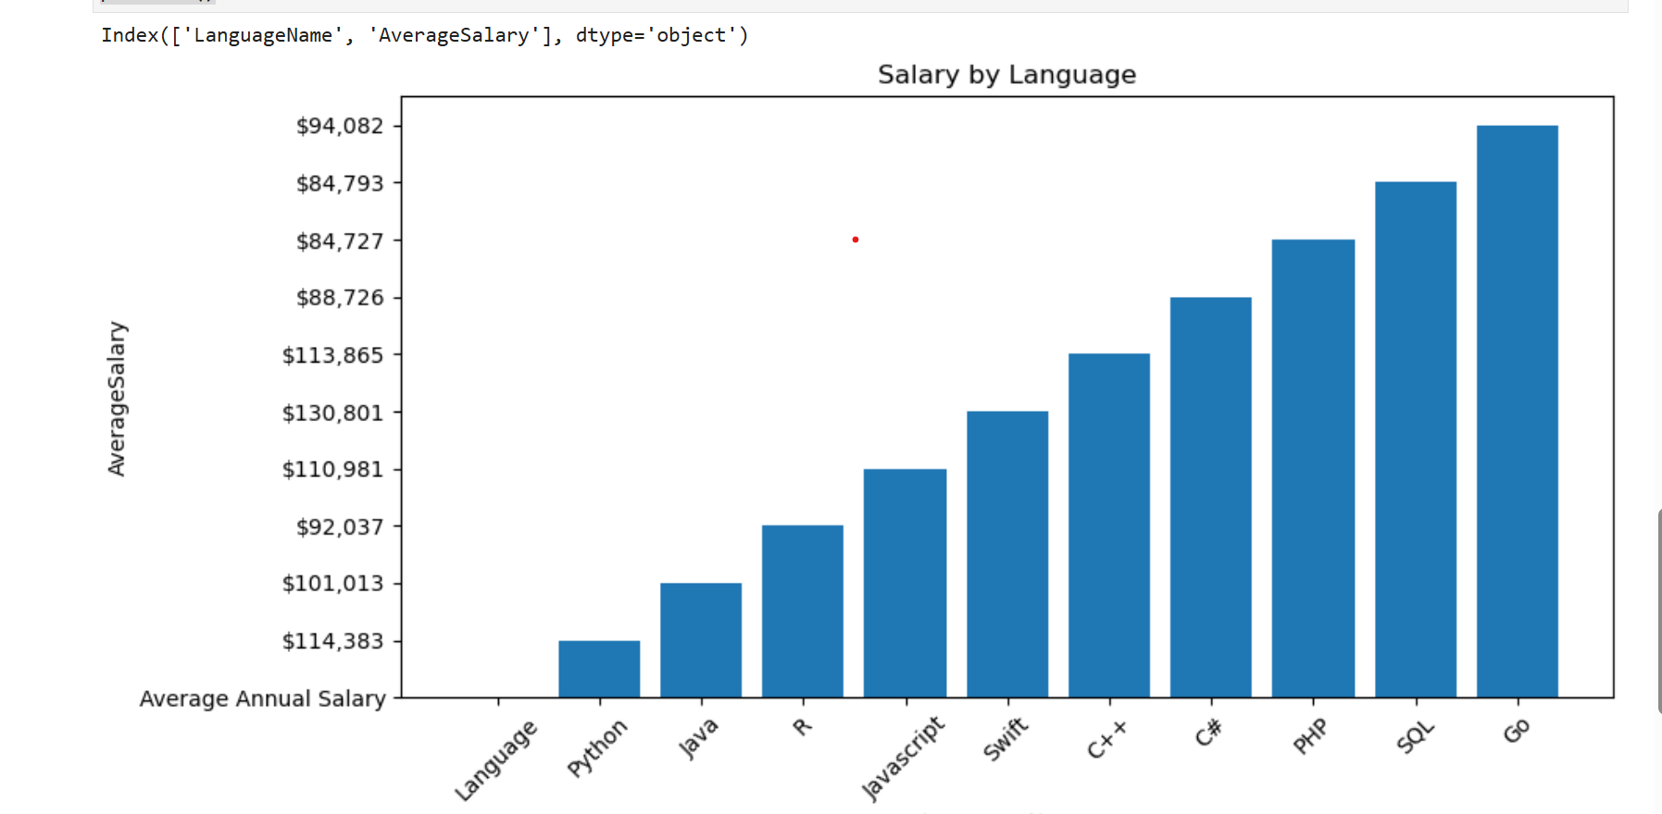
POPULAR LANGUAGES
In Module 1 you have collected the job postings data using web scraping in a file named “popular-languages.csv”. Present that data using a bar chart here. Order the bar chart in the descending order of salary.

Slide 9
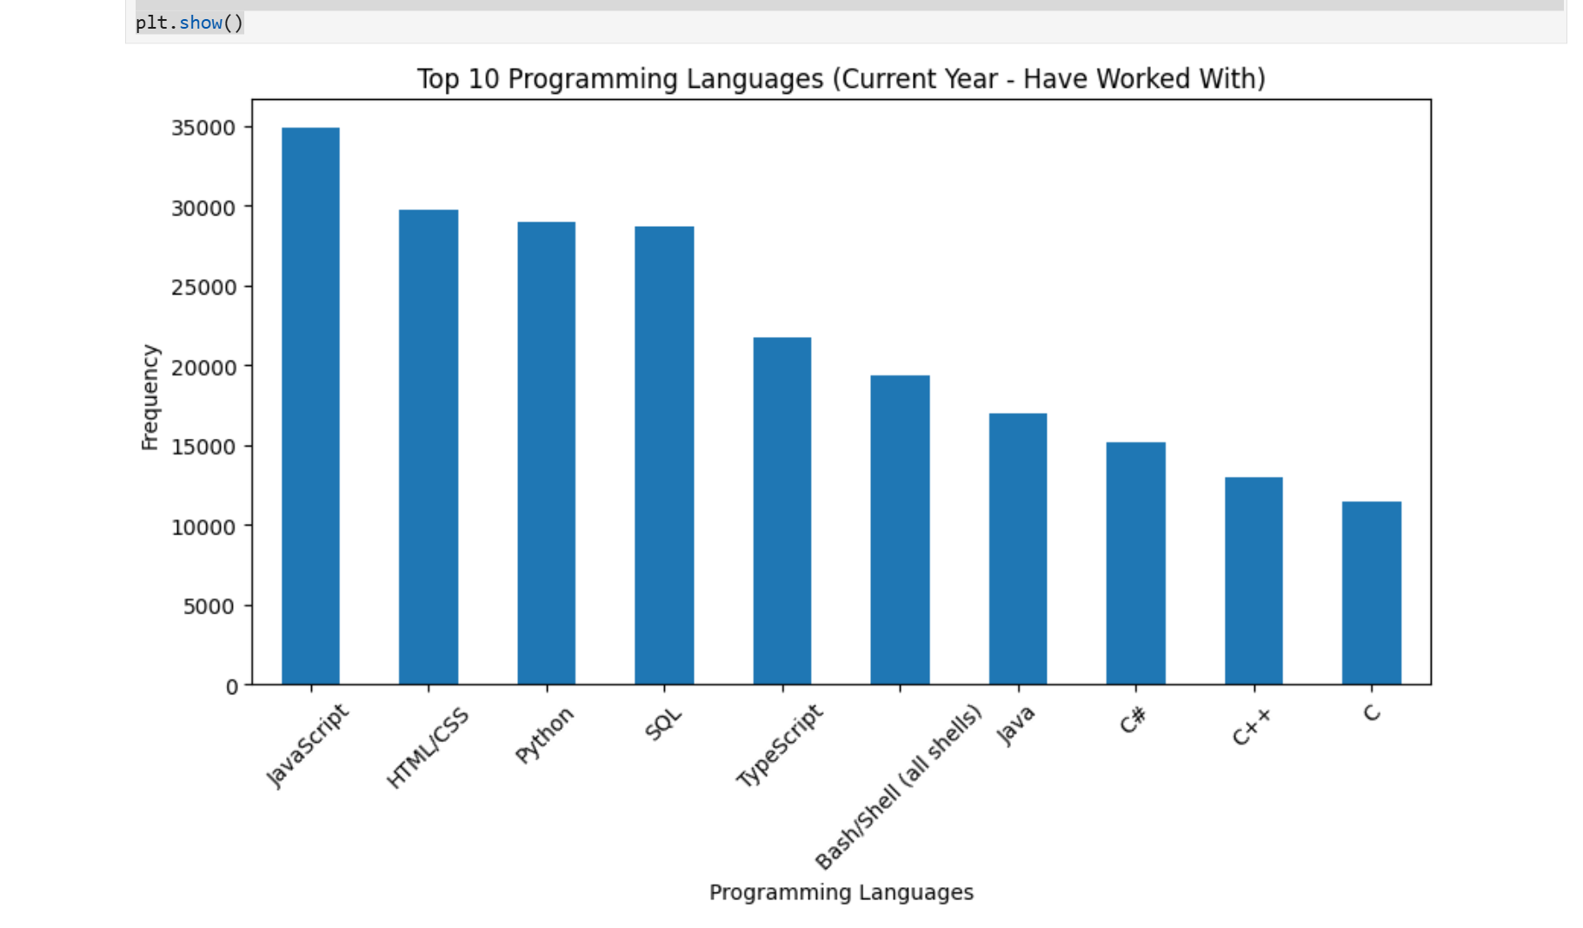
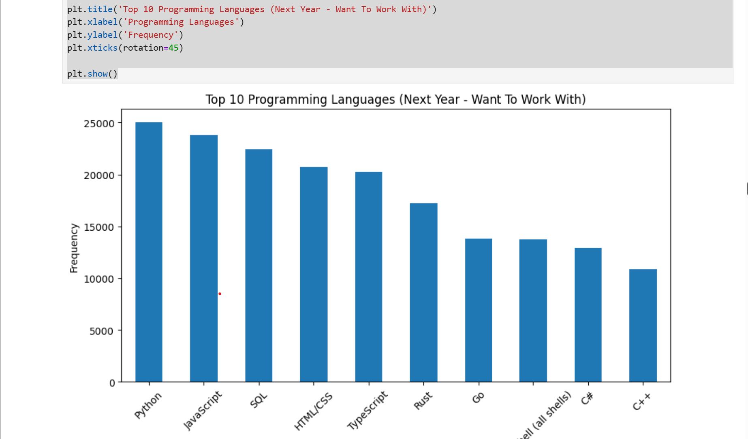
PROGRAMMING LANGUAGE TRENDS
Summarize key trends shown in the charts.
Current Year
Next Year
<Bar chart of top 10 programming languages for the current year goes here.>
< Bar chart of top 10 programming languages for the next year goes here.>

Slide 10
PROGRAMMING LANGUAGE TRENDS - FINDINGS & IMPLICATIONS
Findings
JavaScript is the most widely used programming language in the current job market, indicating strong demand in web development roles.
Python, SQL, and HTML/CSS are highly in-demand skills, showing that data analysis, backend development, and web technologies continue to dominate job requirements.
Languages Like C++, and C# show comparatively lower usage, suggesting they are less frequently required in current job postings compared to modern web and data-focused technologies
Implications
Focus on modern, high-demand languages will improve job opportunities
Since JavaScript and Python dominate both current usage and future interest, learners who prioritize these skills are more likely to secure relevant job roles in web development, AI, and data science.
Core technical skills will remain essential across careers
SQL and HTML/CSS remain consistently relevant, meaning foundational skills in databases and web technologies are necessary regardless of specialization.
Declining demand for traditional languages suggests a shift in industry focus
The lower preference for C, C++, and C# indicates that the industry is moving toward higher-level, flexible technologies, so learners should adapt to modern stacks to stay competitive.

Slide 11
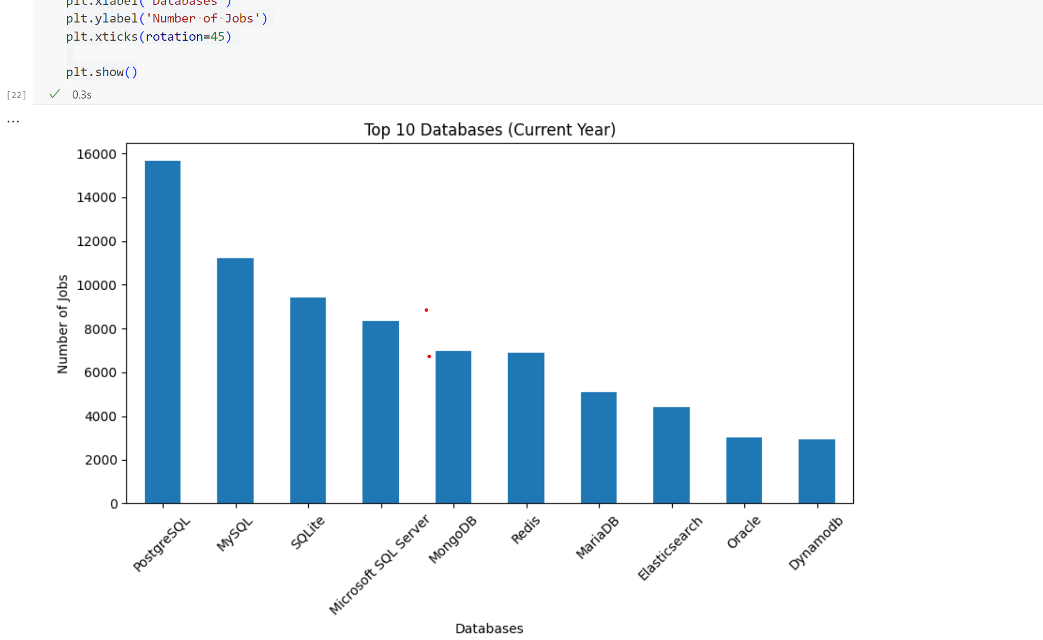
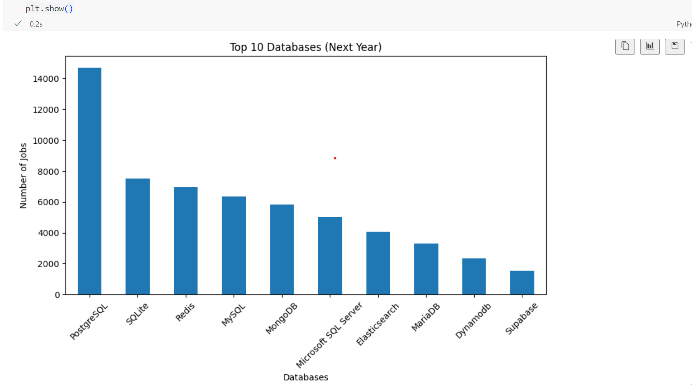
DATABASE TRENDS
Summarize key trends shown in the charts.
Current Year
Next Year
< Bar chart of top 10 databases for the current year goes here >
< Bar chart of top 10 databases for the next year goes here.>

Slide 12
DATABASE TRENDS - FINDINGS & IMPLICATIONS
Findings
PostgreSQL remains the leading database technology in both the current year and projected next year, indicating strong and consistent industry demand.
Cloud-native and modern databases such as Supabase and DynamoDB show increasing adoption in the next year, suggesting a growing shift toward scalable cloud-based solutions.
Traditional relational databases like MySQL and Microsoft SQL Server continue to maintain steady usage, while NoSQL databases such as MongoDB and Redis are expected to see continued growth due to demand for flexible and high-performance data systems.
Implications
Organizations may increasingly invest in PostgreSQL and other highly adopted databases to meet industry demand and ensure long-term scalability and reliability.
The growing adoption of cloud-native and NoSQL databases implies that developers and IT professionals will need to expand their skills in modern database technologies and cloud platforms.
Companies relying only on traditional database systems may face challenges in scalability and flexibility, encouraging a shift toward hybrid architectures that combine relational and NoSQL solutions.

Slide 13

DASHBOARD
<Please present your dashboard in the following slides.>

Slide 14
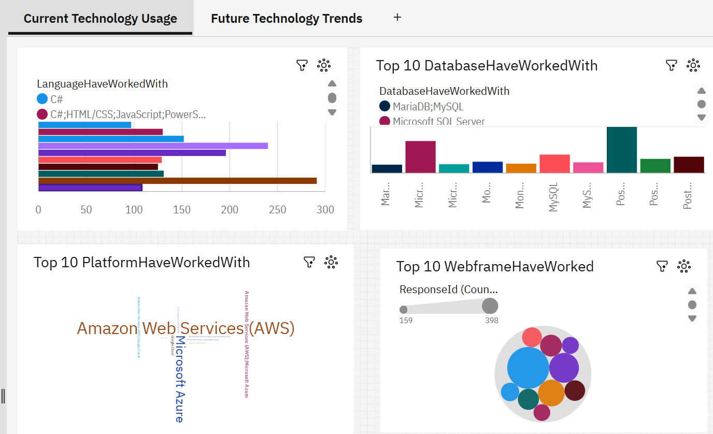
DASHBOARD TAB 1: Current Technology Usage
Screenshot of dashboard tab 1 goes here

Slide 15
DASHBOARD TAB 1: Current Technology Trends
Dashboard Insight
HTML/CSS, JavaScript, TypeScript is the most frequently used languages among surveyed developers whereas C# is the least frequently used among developers
PostgreSQL demonstrated the highest database adoption among surveyed developers whereas MariaDB, MySQL demonstrated the least database adoption among developers
Amazon Web Services demonstrated the highest platform adoption among surveyed developers whereas Google Cloud, Microsoft Azure demonstrated the least platform adoption among developers
Spring Boot demonstrated the highest web framework adoption among surveyed developers whereas Next.js, Node.js, React demonstrated the least web framework adoption among developers
Summarize key insights shown
The average response count across Languages was approximately 159, indicating widespread usage of multiple languages among developers.
The average response count across databases was approximately 376, indicating widespread usage of multiple databases among developers.
The average response count across Platforms was approximately 697, indicating widespread usage of multiple platforms among developers.
The average response count across web frameworks was approximately 222, indicating widespread usage of multiple frameworks among developers.

Slide 16
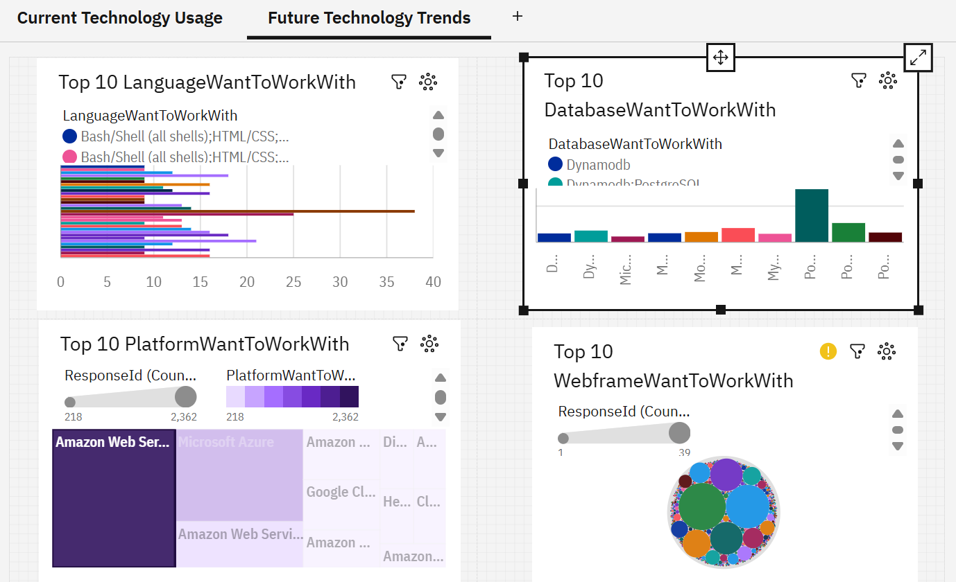
DASHBOARD TAB 2: Future Technology Trends
Screenshot of dashboard tab 2 goes here

Slide 17
DASHBOARD TAB 2: Future Technology Trends
Dashboard Insight
HTML/CSS, JavaScript, and TypeScript emerged as the most preferred languages among developers want to work with in the future, whereas Bash/ Shell(all shells) least preferred among developers.
PostgreSQL emerged as the most preferred databases among developers want to work with in the future, whereas Microsoft SQL Server as the least preferred among developers.
Amazon Web Services emerged as the most preferred platforms among developers want to work with in the future, whereas Amazon Web Services; Digital Ocean as the least preferred among developers.
Spring Boot emerged as the most preferred web framework among developers want to work with in the future, whereas Flask as the least preferred among developers.
Summarize key insights shown
The average response count across Languages was approximately 127, indicating widespread preference of multiple languages among developers.
The average response count across databases was approximately 441, indicating widespread preference of multiple databases among developers.
The average response count across web frameworks was approximately 257, indicating widespread preference of multiple frameworks among developers.

Slide 18
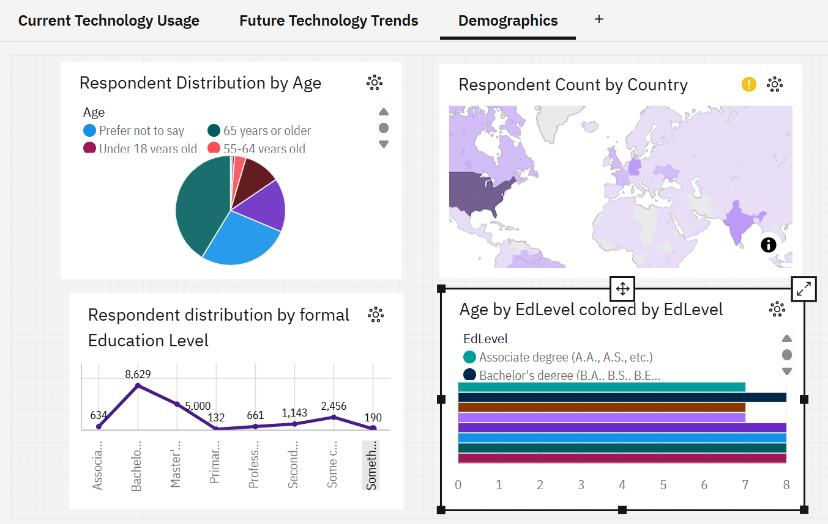
DASHBOARD TAB 3: Demographics
Screenshot of dashboard tab 3 goes here

Slide 19
DASHBOARD TAB 3: Demographics
Dashboard Insights
Developers aged 25–34 represented the largest demographic group in the survey, followed by respondents in the 35–44 age category, indicating strong participation from early- to mid-career professionals.
Niger reported the highest total compensation values despite having relatively low survey participation, ranking 147th in the number of distinct respondents.
Respondents with a Bachelor’s degree represented the largest educational group in the survey, followed by those holding a Master’s degree, highlighting the strong presence of higher education qualifications among developers whereas respondents with only primary or elementary school education and alternative educational backgrounds represented the smallest share of survey participants.
Respondents with Bachelor’s degrees and Professional degrees showed the highest average age levels among surveyed education groups whereas respondents holding Associate and Master’s degrees represented the younger age groups within the survey demographics.
Summarize demographic insights
Belize showed a unique demographic pattern, with the highest survey participation coming from respondents aged 65 years or older, unlike most countries where the 25–34 age group represented the largest share of respondents.
The United States had the highest survey participation among respondents, followed by Germany, indicating strong developer representation from these countries.
Country Niger is unique in that it has the highest ResponseId from EdLevel Professional degree (JD, MD, Ph.D, Ed.D, etc.) at 1, compared to peers that have highest ResponseId from EdLevel Bachelor's degree (B.A., B.S., B.Eng., etc.).
Italy demonstrated a distinct educational trend, where respondents with Professional degrees represented the highest age category, unlike most countries where Bachelor’s degree holders formed the dominant age group.

Slide 20
DISCUSSION
Front-end and full-stack technologies such as HTML/CSS, JavaScript, and TypeScript dominated both current usage and future developer preferences, highlighting their continued importance in modern software development.
PostgreSQL emerged as the leading database technology for both current adoption and future interest, demonstrating strong trust in open-source relational database systems.
Amazon Web Services maintained the highest platform adoption and future preference among developers, reinforcing the growing reliance on cloud computing technologies.
Spring Boot showed strong adoption and future demand among web frameworks, indicating increasing preference for enterprise-level backend development solutions
Developers commonly work with multiple technologies simultaneously, as reflected by the high average response counts across languages, databases, platforms, and frameworks.
The majority of survey participants belonged to the 25–34 and 35–44 age groups, representing strong participation from early- and mid-career professionals
Bachelor’s and Master’s degree holders formed the largest educational groups among respondents, emphasizing the strong presence of higher education qualifications within the developer community.

Slide 21
OVERALL FINDINGS & IMPLICATIONS
Findings
The developer workforce is primarily concentrated in professionally experienced age groups with strong academic backgrounds.
The United States and Germany contributed the highest survey participation, indicating strong representation from major global technology markets.
Unique regional trends were identified, including:
Belize having higher participation from older age groups,
Niger showing unusually high compensation values despite low participation,
Italy displaying stronger representation of professional degree holders in older age categories.
Implications
The growing adoption of multiple technologies implies that developers must continuously upskill and maintain cross-functional technical expertise.
Cloud computing and scalable backend technologies are expected to remain central to future digital transformation initiatives.
Global differences in demographics, compensation, and education highlight the importance of region-specific workforce and hiring strategies.

Slide 22

CONCLUSION
The survey demonstrates that modern full-stack development, cloud computing, and open-source technologies are shaping the future of the software industry.
PostgreSQL, AWS, JavaScript, and Spring Boot emerged as key technologies with both strong current adoption and future growth potential.
The software development workforce is largely composed of educated early- and mid-career professionals with diverse technical skill sets.
The findings indicate a continuing shift toward cloud-native architectures, enterprise backend solutions, and multi-technology development environments
Overall, the dashboard analysis provides valuable insights into current developer trends, future technology preferences, and evolving global workforce patterns within the software industry

Slide 23

APPENDIX
Include any relevant additional charts, or tables that you may have created during the analysis phase.
Dataset used:
survey_data_updated.csv
Table Created
main

